Slide 1
DynamoDB- cntd

Slide 2
What is DynamoDB
Amazon DynamoDB is a key-value and document database that delivers single-digit millisecond performance at any scale.
It's a fully managed, multiregion, multimaster database with built-in security, backup and restore, and in-memory caching for internet-scale applications.
DynamoDB can handle more than 10 trillion requests per day and support peaks of more than 20 million requests per second.

Slide 3
Many of the world's fastest growing businesses such as Lyft, Airbnb, and Redfin as well as enterprises such as Samsung, Toyota, and Capital One depend on the scale and performance of DynamoDB to support their mission-critical workloads.
More than 100,000 AWS customers have chosen DynamoDB as their key-value and document database for mobile, web, gaming, ad tech, IoT, and other applications that need low-latency data access at any scale.
Create a new table for your application and let DynamoDB handle the rest.

Slide 4
Benefits
PERFORMANCE AT SCALE
supports some of the world’s largest scale applications by providing consistent, single-digit millisecond response times at any scale.
can build applications with virtually unlimited throughput and storage. DynamoDB global tables replicate your data across multiple AWS Regions to give you fast, local access to data for your globally distributed applications.
SERVERLESS
there are no servers to provision, patch, or manage and no software to install, maintain, or operate.
automatically scales tables up and down to adjust for capacity and maintain performance.
ENTERPRISE READY
supports ACID transactions to enable you to build business-critical applications at scale.
. You can create full backups of hundreds of terabytes of data instantly with no performance impact to your tables, and recover to any point in time in the preceding 35 days with no downtime.

Slide 5
Use cases
SERVERLESS WEB APPLICATIONS → Build powerful web applications that automatically scale up and down. You don't need to maintain servers, and your applications have automated high availability.
MICROSERVICES DATA STORE → Build flexible and reusable microservices using DynamoDB as a serverless data store for consistent and fast performance.
MOBILE BACKENDS → Build personalized mobile apps with smooth experiences for your users. DynamoDB takes care of operational tasks so that you can focus on your applications.
AD TECH → Create real-time bidding platforms and recommendation engines with the scalability, throughput, and availability of DynamoDB.
GAMING → Create responsive games for mobile, console, and desktop with DynamoDB. Store and query game data such as player state, high scores, or world dynamic content.
IOT → Analyze your devices by connecting your high-velocity, high-volume IoT data in DynamoDB to Amazon Redshift and Amazon QuickSight.

Slide 6
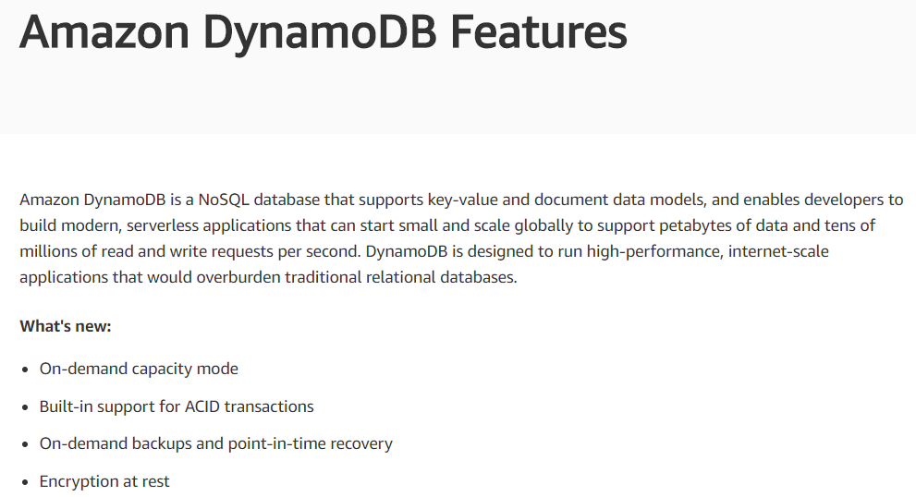

Slide 7
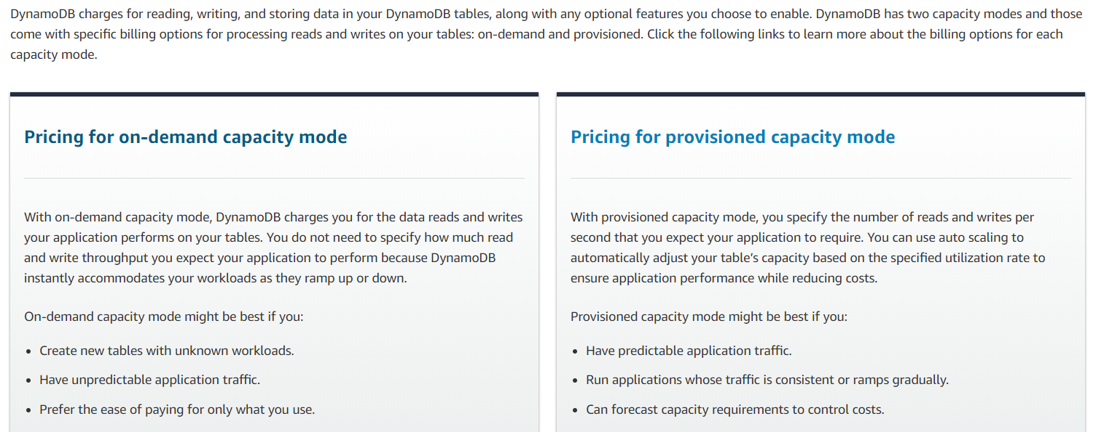
Amazon DynamoDB Pricing

Slide 8
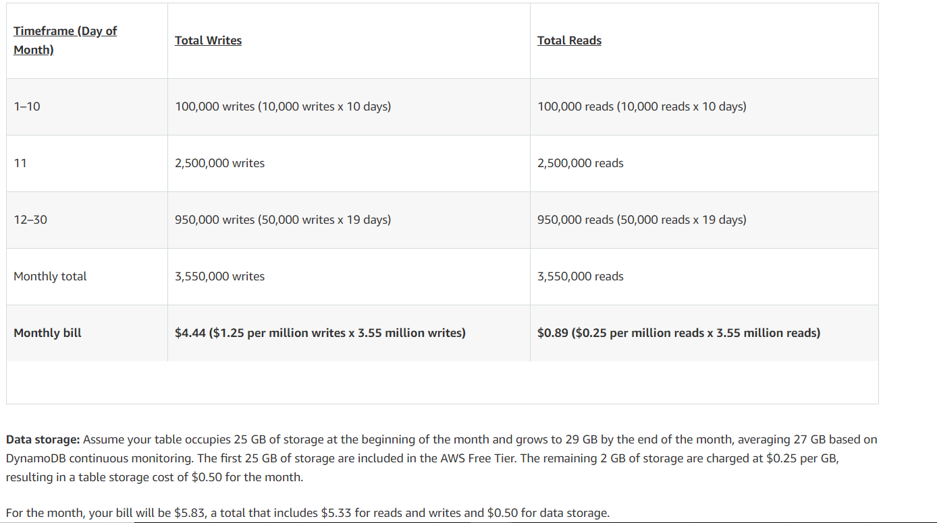
Amazon DynamoDB Pricing

